Slide 1
Image caption

Slide 2
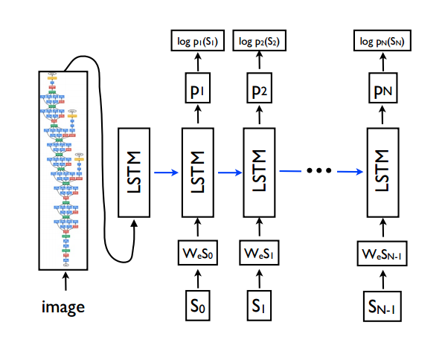

Slide 3
command
sudo apt-get install tmux
Ctrl+B C create window
Ctrl+B X delete window
Ctrl+B P previous window
Ctrl+B N next window
unzip XXX.zip

Slide 4
Dataset
MS COCO 2014
http://images.cocodataset.org/zips/test2014.zip X
http://images.cocodataset.org/zips/train2014.zip
http://images.cocodataset.org/zips/val2014.zip
http://images.cocodataset.org/annotations/image_info_test2014.zip
http://images.cocodataset.org/annotations/annotations_trainval2014.zip

Slide 5
Pretrained checkpoint
http://download.tensorflow.org/models/inception_v3_2016_08_28.tar.gz
tar -xvf inception_v3_2016_08_28.tar.gz

Slide 6
Step 1
~/img_caption
/image2txt model # FB code
/COCO_captioning # annotation
captions_train2014.json
captions_val2014.json
/train2014 # training img
/val2014 # validation img

Slide 7
Data preprocessing
Vocabulary list
Two dictionaries
Pad all captions
Extract image features
Index train image and validation image

Slide 8
command
python prepare_captions.py --file_dir ../COCO_captioning/ --total_vocab 2000 --padding_len 25
python extract_features.py --model_dir ..
python extract_features.py --model_dir .. --image_dir ../val2014 --save_dir ../COCO_captioning/val2014_v3_pool_3
val/19896.jpg has error, please use val/19897.jpg to replace it.

Slide 9
Problems that may occured
Can’t install h5py locale problem
export LC_ALL=C in ~/.bashrc, then source ~/.bashrc
pip install scipy
pip install Pillow

Slide 10
X11 forwarding
/etc/ssh/ssh_config
X11Forwarding yes
X11DisplayOffset 10
sudo service ssh restart
xclock

Slide 11
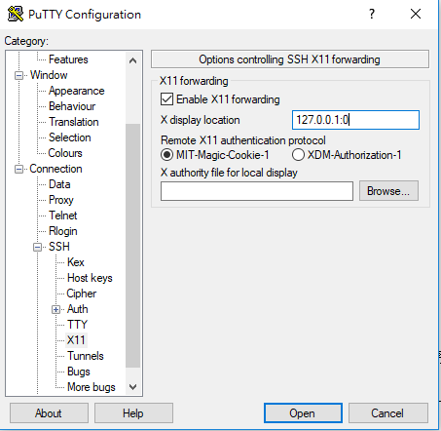
SSH X11 Forwarding in Windows
127.0.0.1:0
Step1: download Xming X Server
https://sourceforge.net/projects/xming/
Step2: setting your PuTTY
Connection>>SSH>>X11
Step3: testing
xclock

Slide 12
Run
python train.py

Slide 13
reference
https://github.com/aaxwaz/Image-Captioning-Model-in-TensorFlow
https://weiminwang.blog/2017/03/20/using-tensorflow-to-build-image-to-text-deep-learning-application/

